Slide 1

High Impact Skills Development Program
in Artificial Intelligence, Data Science, and Blockchain
Module 8: Object Detection & Recognition Using CNN
Lecture 5: Vision Transformers
Instructor: Ahsan Jalal

Slide 2
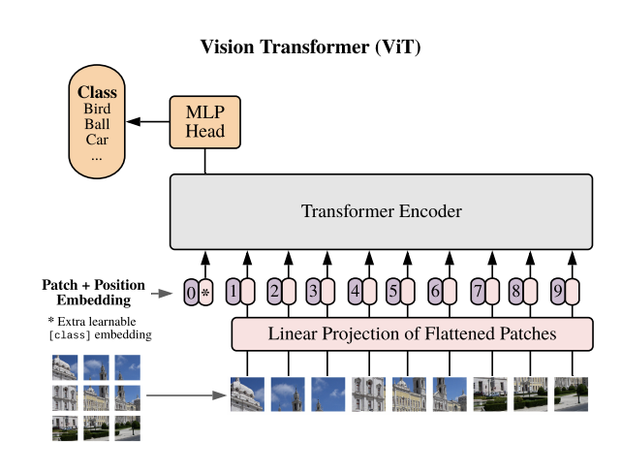
Introduction to Vision Transformers
Vision Transformer (ViT) is a model for image classification that leverages the transformer architecture.
Initially designed for natural language processing (NLP) tasks (e.g., BERT, GPT), transformers are now applied to visual data.
ViT splits an image into patches and processes them as tokens, similar to words in text.
First introduced in the paper "An Image is Worth 16x16 Words: Transformers for Image Recognition at Scale" by Dosovitskiy et al. (2020).

Slide 3
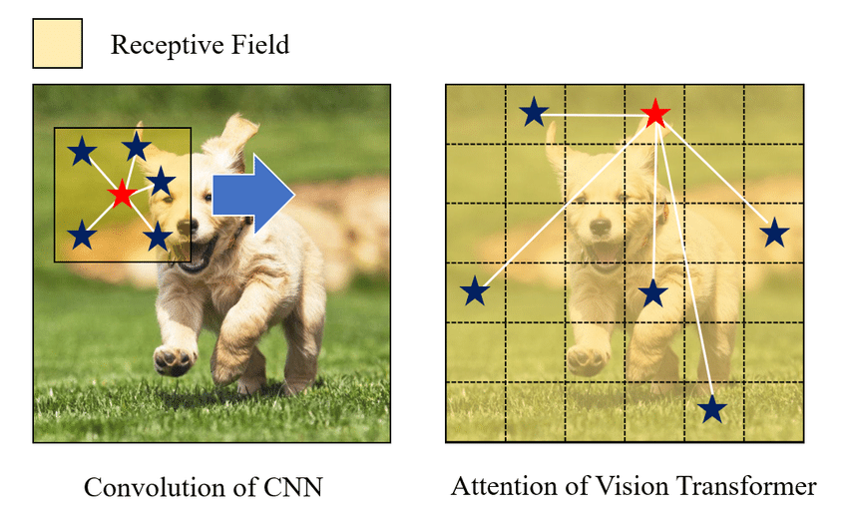
Why Transformers for Vision
CNNs were used for image recognition, using convolutional layers to detect local features (edges, textures).
CNNs are limited in capturing long-range dependencies due to their local receptive fields.
Transformers on the other hand better at modeling global relationships in data.
Advantages of ViT:
Captures long-range dependencies across the entire image.
Can scale well with large datasets.

Slide 4
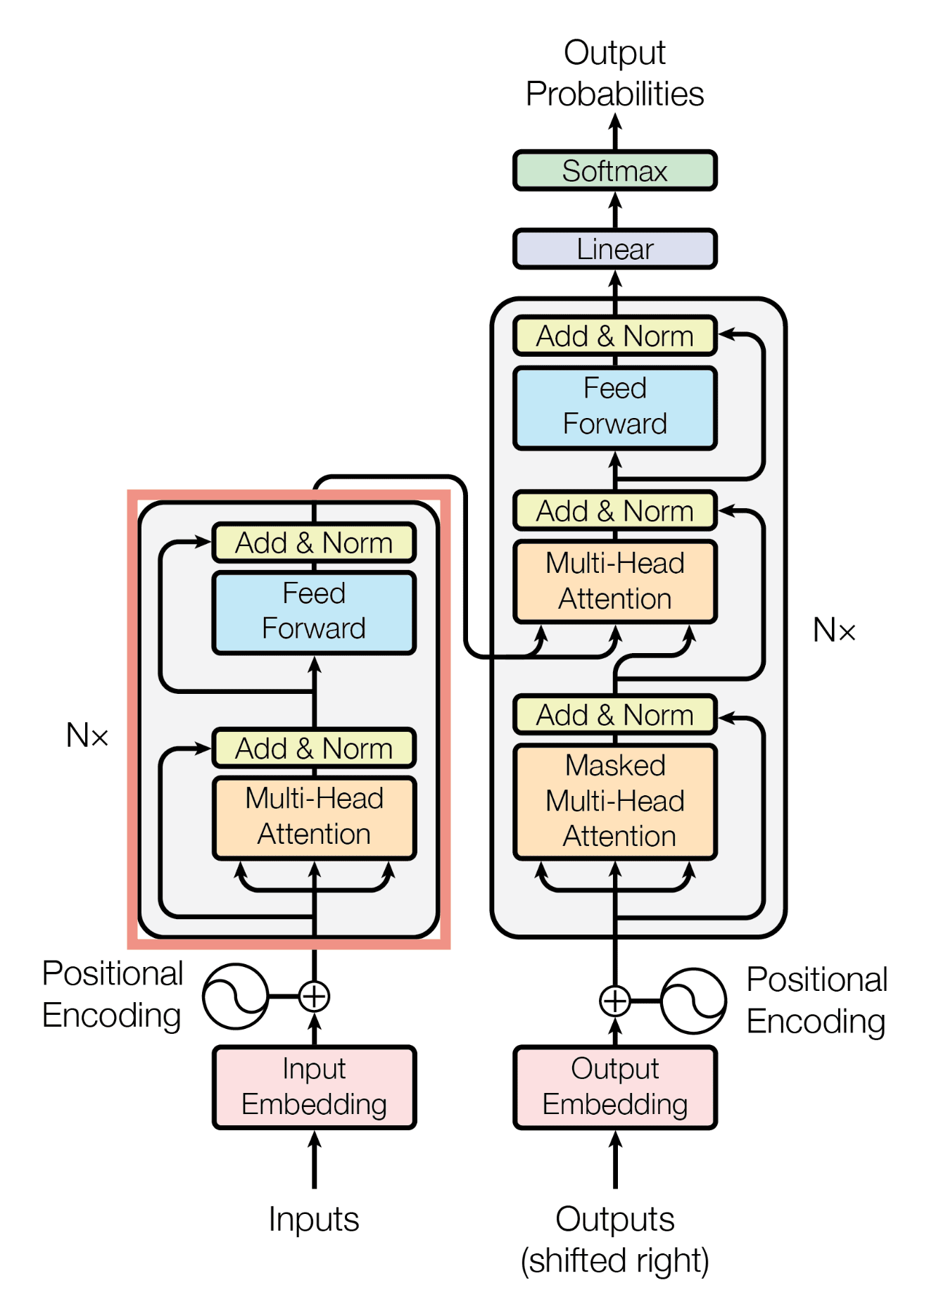
What are Transformers?
Transformers originated in NLP (Natural Language Processing) for sequence-to-sequence tasks.
Key concept: Self-attention mechanism—every element in a sequence attends to every other element.
Captures long-range dependencies, making it ideal for complex visual tasks.

Slide 5
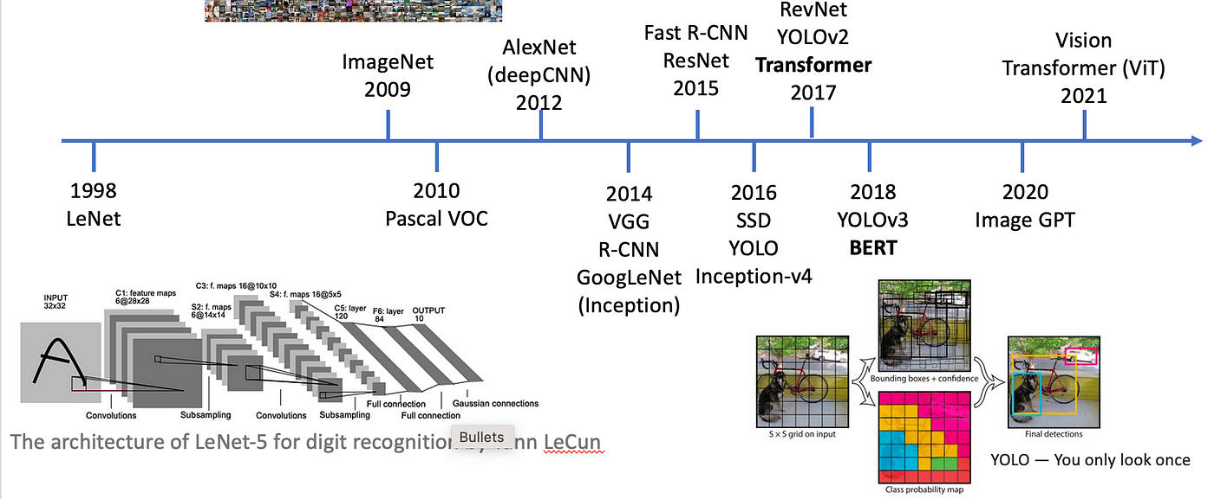
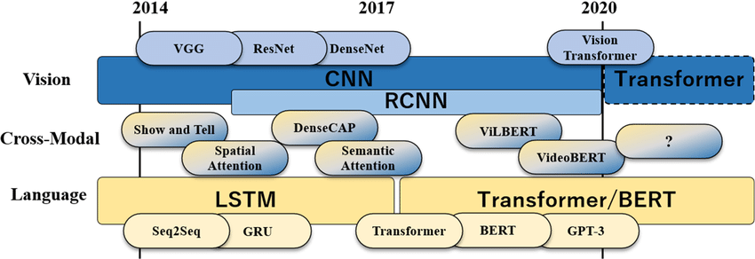
Evolution of Transformer-based Object Detection
DETR (2020): First pure Transformer-based model for object detection.
Deformable DETR (2021): Improved efficiency with deformable attention.
Vision Transformers (ViTs)
Efficient DETR: Combines efficiency with transformer benefits for object detection.

Slide 6
Components of Transformer
Encoder-decoder architecture
Self-attention mechanism
Positional encoding

Slide 7



Attention Mechanism
Attention: Helps to focus on important words in a given input sequence

Slide 8



Self-Attention in Transformers
Self Attention: Not relying on the external stimulus as compared to simple attention
We get the meaning of the word by paying attention to the context in which it appears.
Focuses on words in the same sentence to get the attention.

Slide 9
Self-Attention Mechanism
Self Attention: The context “ empty account” indicate first word “bank” is finance institute
While the word “river” indicates the second “bank” is a river bank.

Slide 10

Positional Encoding
Why word order matters ?
Positional encoding adds position information to tokens, as transformers don't have a built-in sense of order.

Slide 11
Vision Transformers
Patch Embeddings:
Break down image into fixed-size patches and process them as sequences.
Each patch is flattened and linearly embedded into fixed-size vector.
Positional Encodings:
Positional information is added into patch embedding to retain spatial structure.
Self-Attention:
Embeddings are passed to transformer’s encoder which applies self-attention.
Self-attention captures relation between patches and extract global context.
CLS Token:
A special token is prepended to the sequence, whose final representation is used for classification.
MLP Head:
It receives Encoder’s output in the form of token embeddings.
It consists of a feed-forward network transforms the input into high dimensional feature space

Slide 12
Vision Transformers
Class Prediction:
Final layer of MLP is a linear layer with nodes equal to number of classes in classification task.
It projects the transformed token embeddings onto the class space, producing class probabilities or logits for each input image.

Slide 13
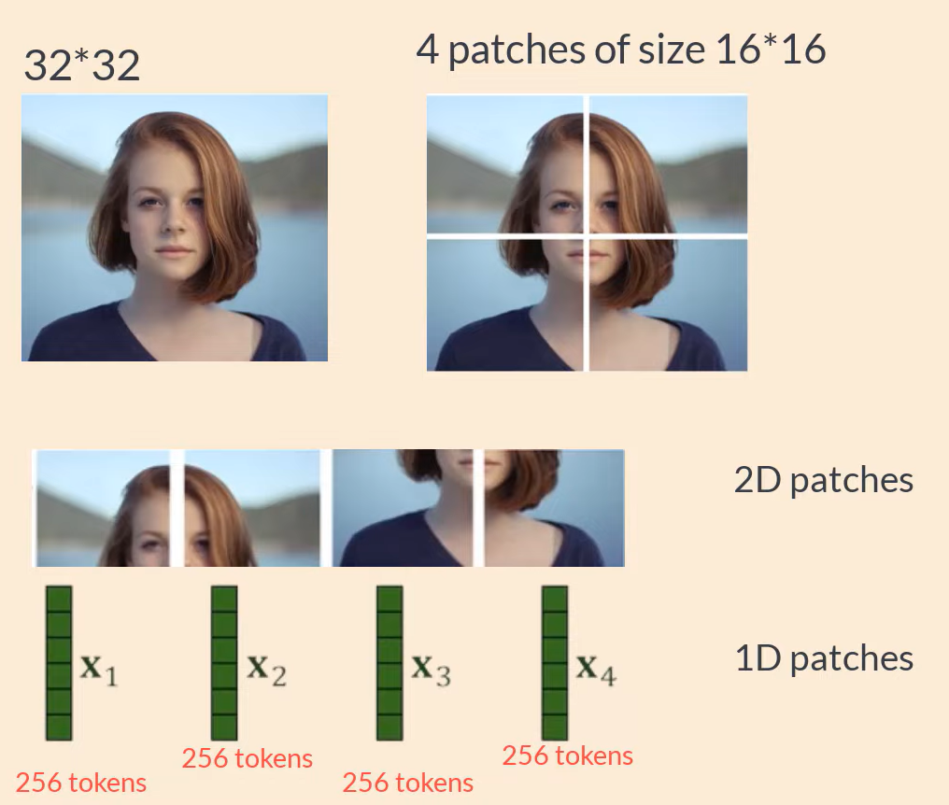
Vision Transformers
Input image split into patches (e.g., 16x16 patches for a 224x224 image, resulting in 196 patches).
Flatten each patch and project it into a fixed-dimensional vector using a linear projection.
Add positional embeddings to each patch vector.
Pass to transformer model for further process.
Extract the final classification from the output of the classification token.

Slide 14
Positional Encoding
Transformers have no built-in notion of spatial information (like CNNs).
To retain positional information, ViT adds positional encodings to each patch vector.
Positional encodings allow the model to understand the position of each patch in the image.
Typically, sine and cosine functions are used to encode positions, similar to how they are used in NLP transformers.

Slide 15
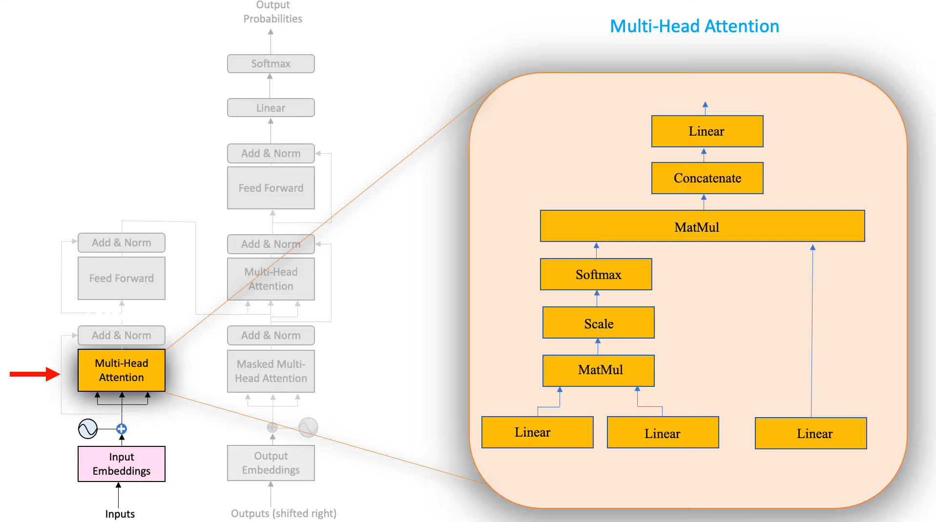
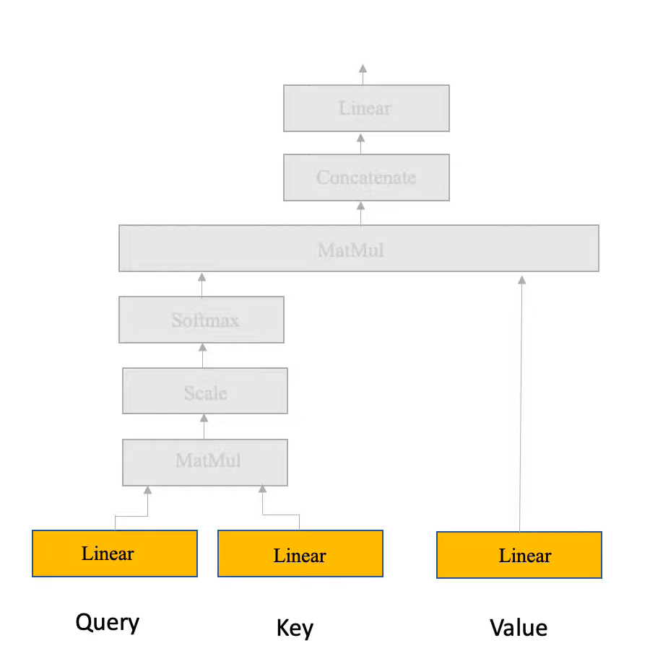
Transformer Attention Mechanism
Query, Key, and Value: Each element in the sequence is represented by a query, key, and value vector.

Slide 16
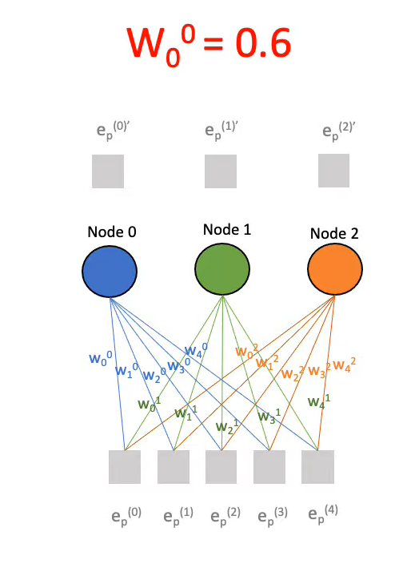
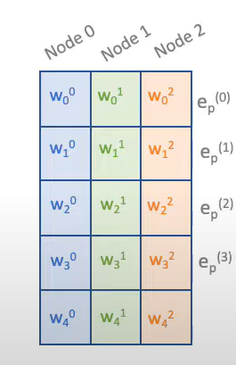
Linear Layer
Linear Layer:
Each node in linear layer is connected to input using scaler set of weights
Model updates the weights during back-propagation.
Weights are fed to the model as matrix

Slide 17
Query, Key & Value
Significance of Query, Key and Value vectors !

Slide 18
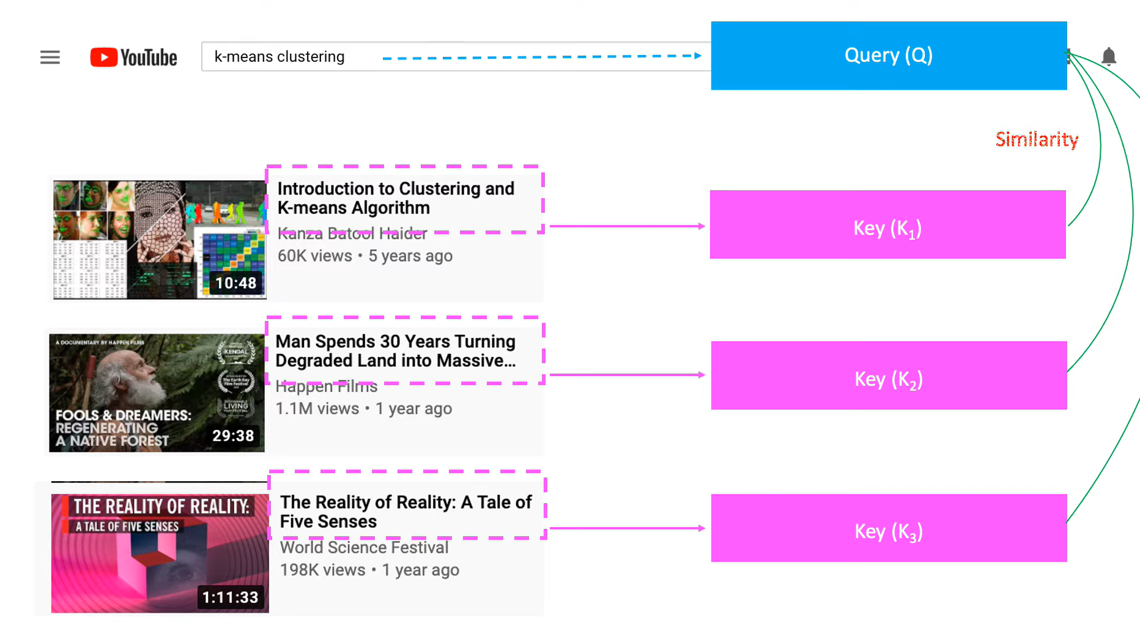
Query, Key & Value

Slide 19
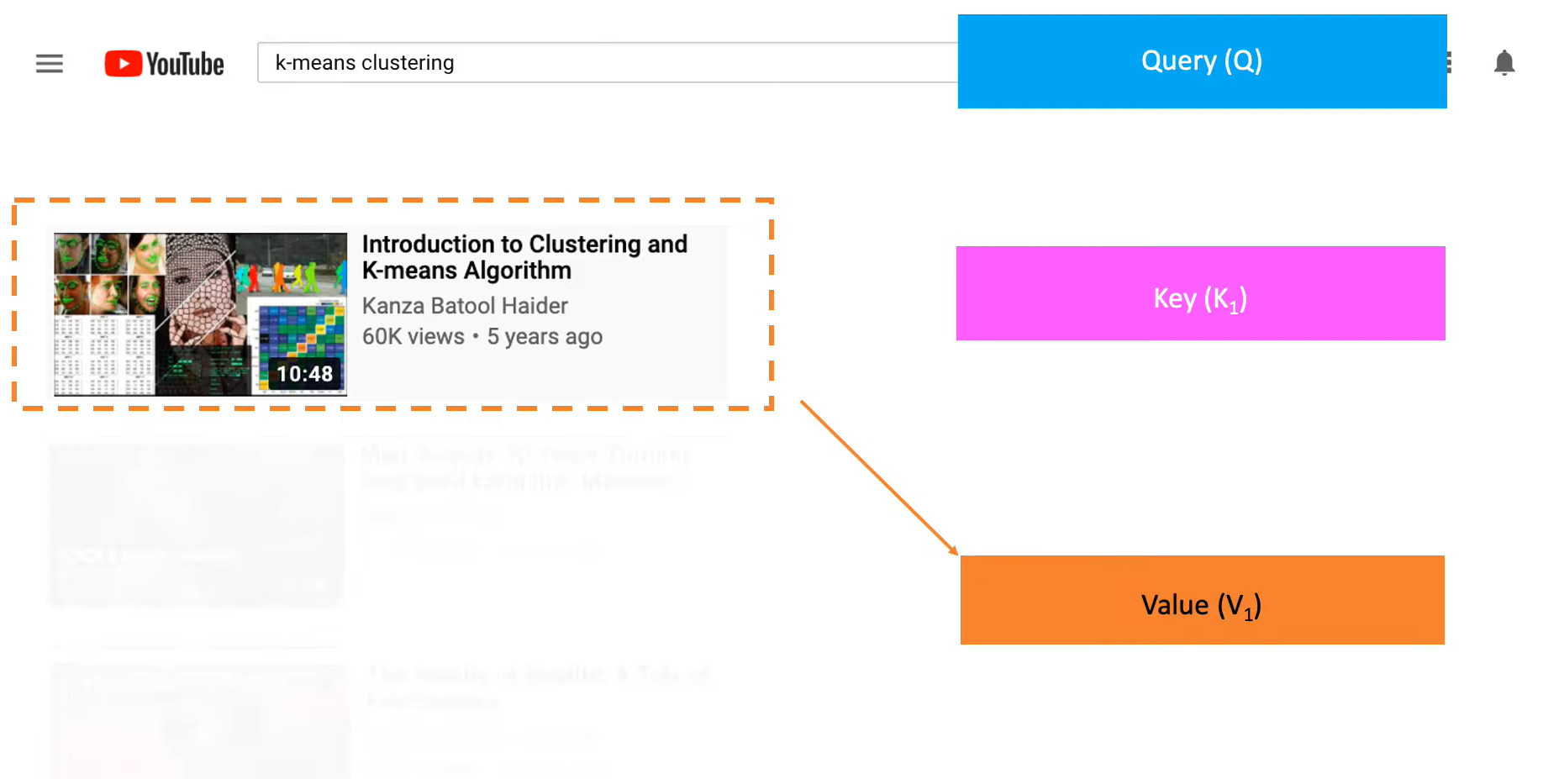
Query, Key & Value

Slide 20
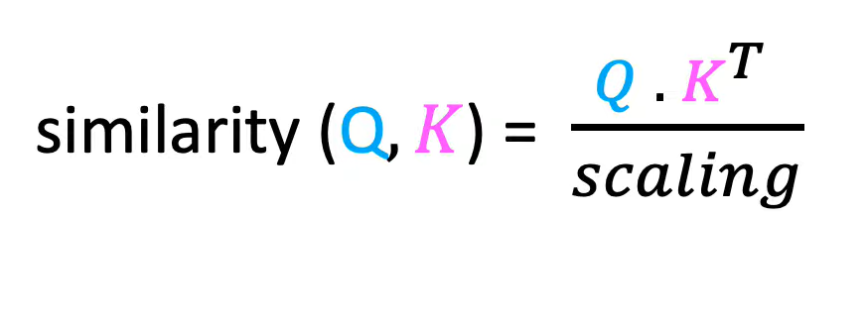
Similarity Calculation
Cosine similarity is used to calculate similarity between Query and Keys.

Slide 21
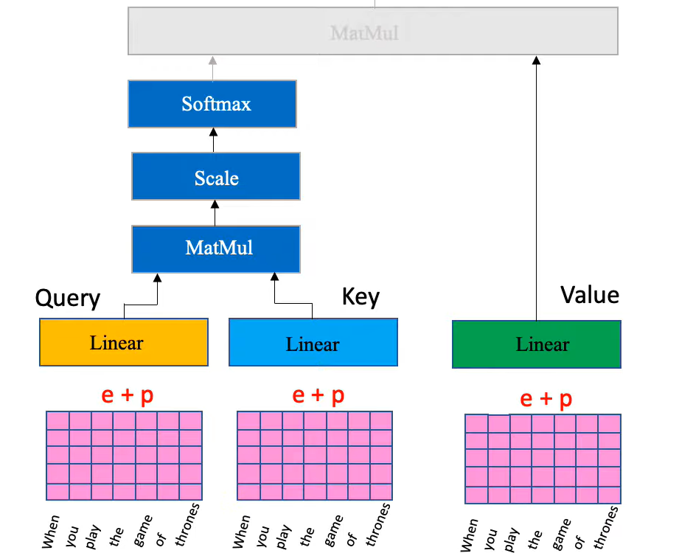
Input to Linear Layers
Copies of input embeddings with positional embeddings are passed to linear layers to get Q,K and V vectors.

Slide 22
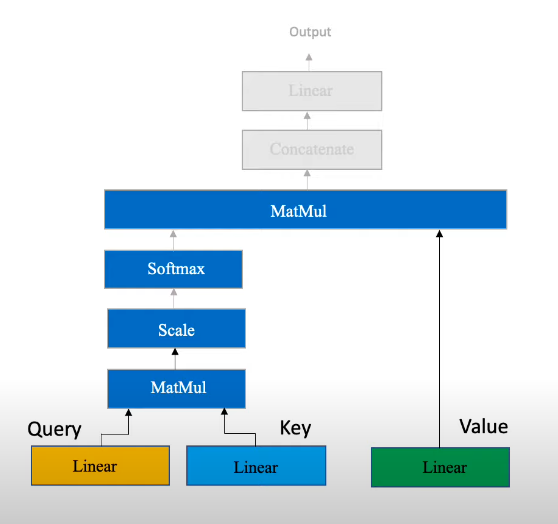
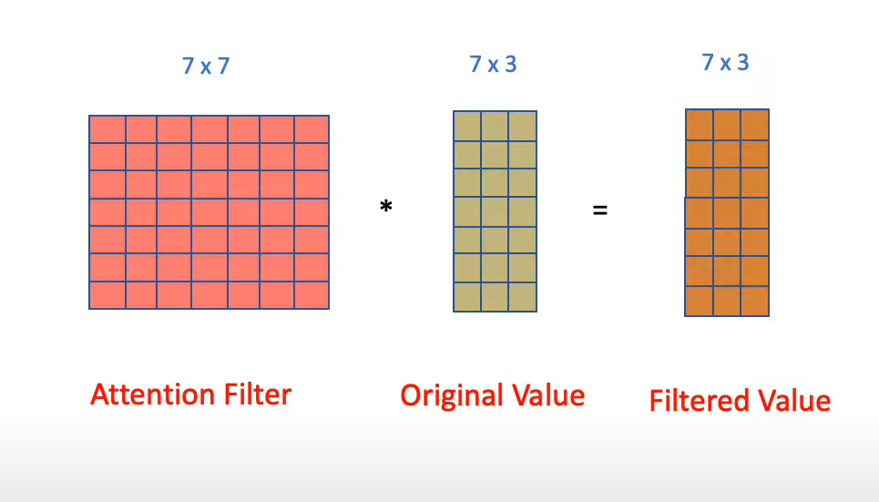
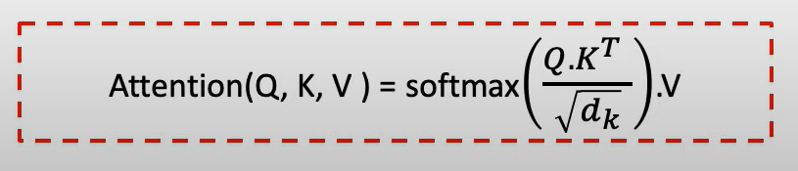
Filtered Output
Filtered output is generated using Attention filter and Value vector.

Slide 23
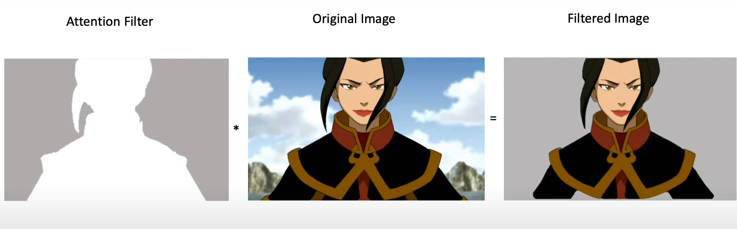
Significance of Attention filter
Attention filter highlights important data while attenuates less useful data.

Slide 24
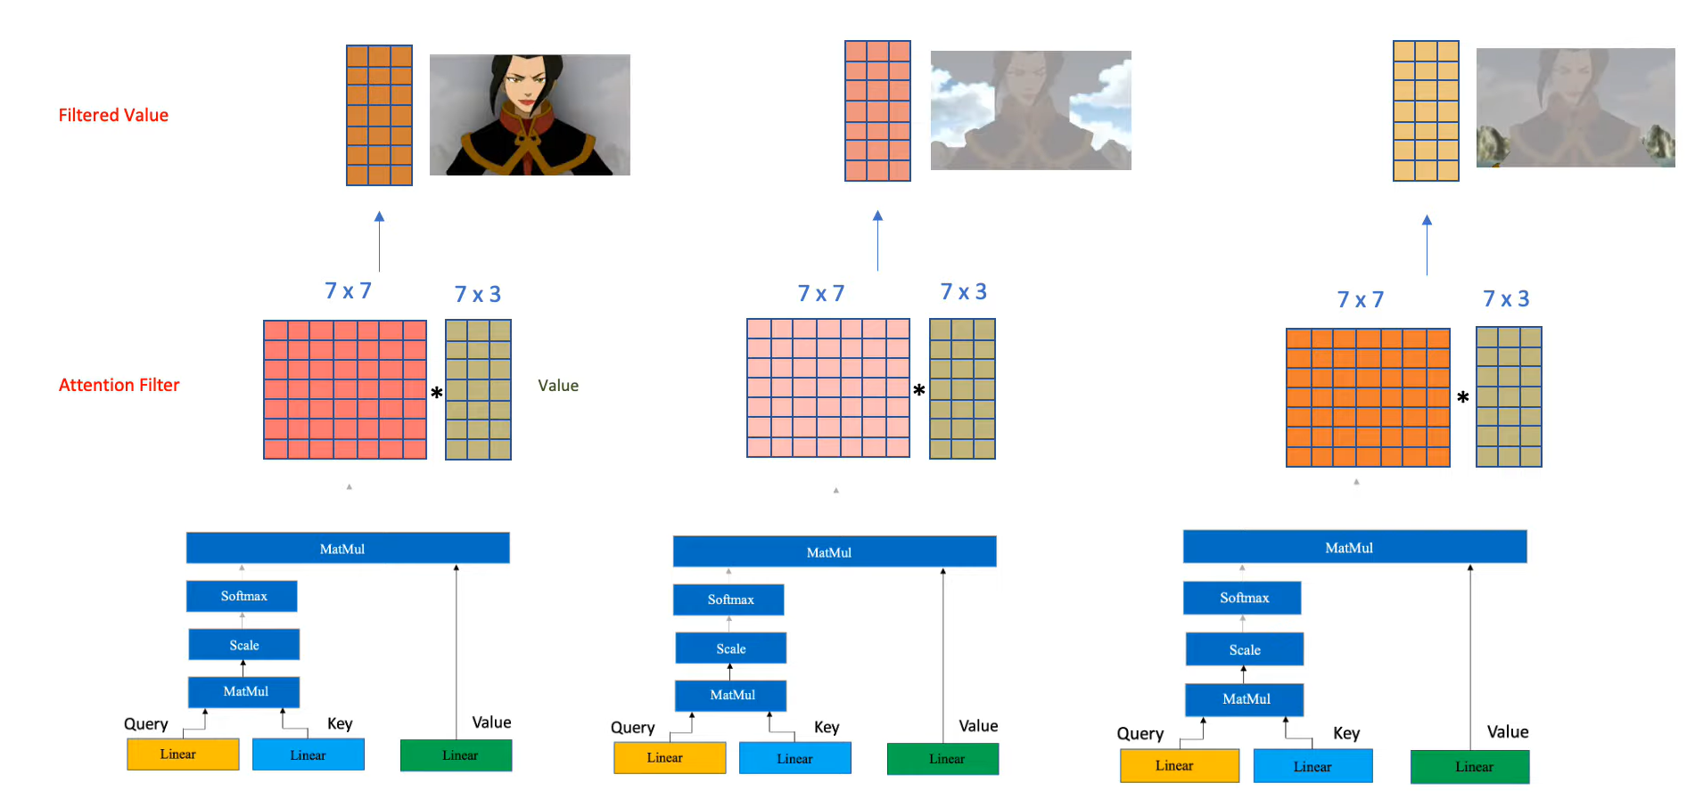
Multi-head Attention
Multi-head attention pays attention to different features.

Slide 25
Advantages
ViT models can capture long-range dependencies and global context, which CNNs struggle with.
Unlike CNNs, ViTs are fully parallelizable, speeding up training with modern hardware (like TPUs).
ViT scales well with the amount of data and model size, often outperforming CNNs on larger datasets.
ViTs require large amounts of data for pretraining.
ViTs demand high computational power due to the quadratic complexity of self-attention with respect to the number of patches.

Slide 26
Challenges
ViTs require large datasets for effective training due to fewer inductive biases.
Transformer models are generally more computationally intensive compared to CNNs.
Without large datasets, ViTs may underperform compared to CNNs on smaller datasets.

Slide 27
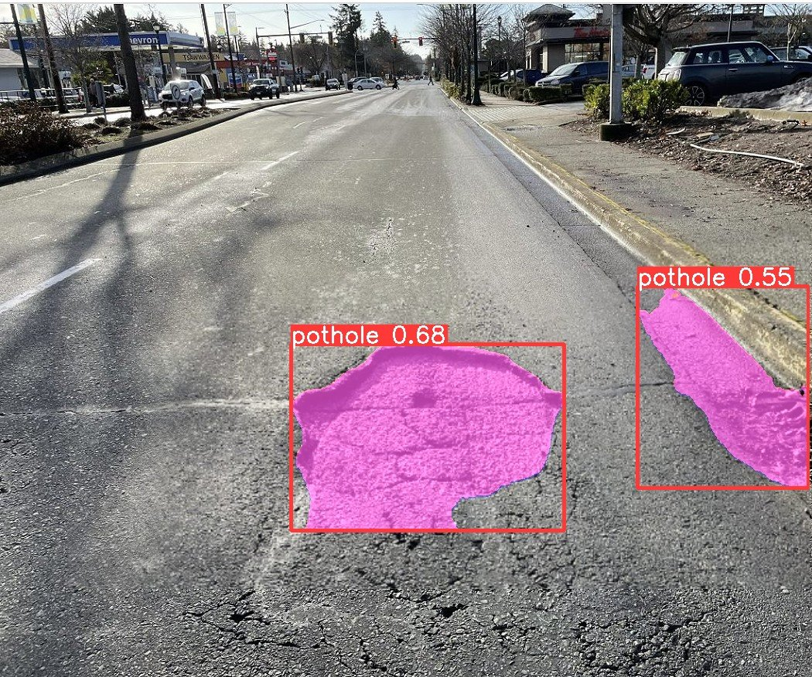
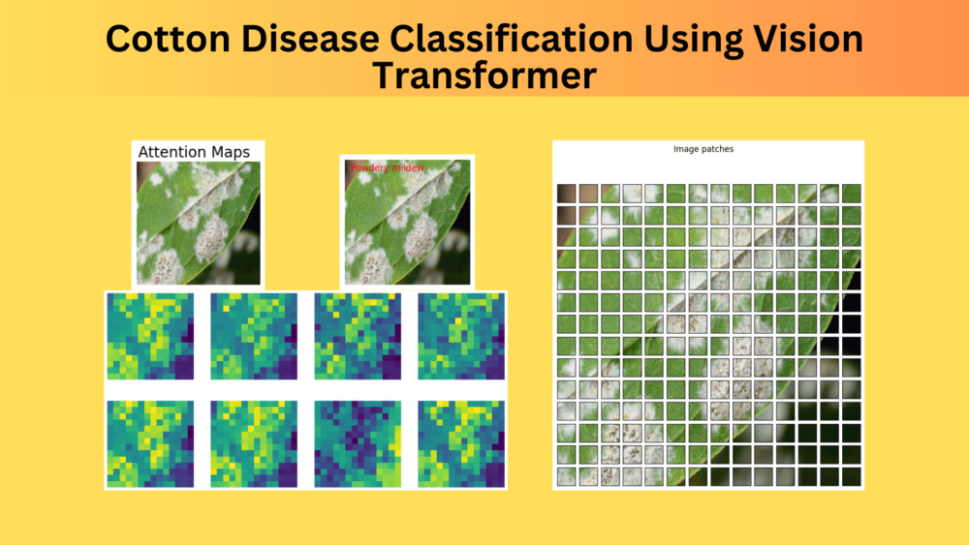
Applications
ViT can be used in tasks like ImageNet classification.
Extensions of ViT (like DETR) are used for detecting objects in images.
ViT models can be applied for segmentation tasks (e.g., medical imaging).

Slide 28
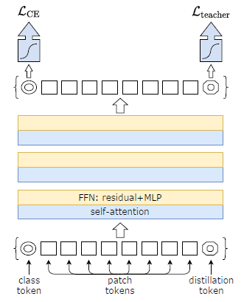
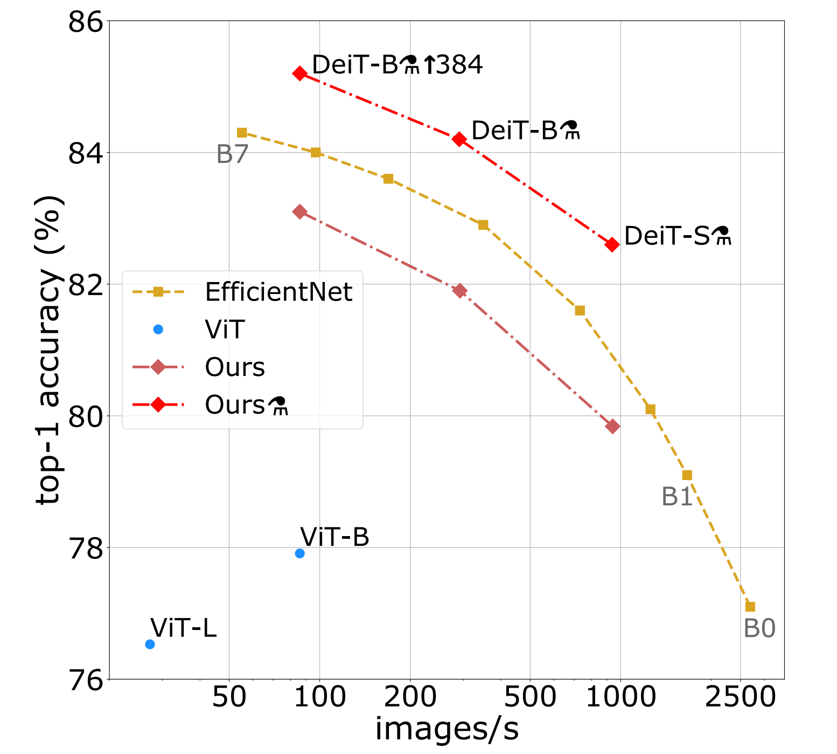
Vit Variants
DeiT (Data-efficient ViT): A variant of ViT designed to perform well with fewer training data, introduced by Touvron et al.
Used Distillation (teacher-student) method assuming we have access to a strong image classifier as teacher model.
Distillation token is added which interact with patch and class tokens via self-attention layers
Objective is to reproduce the label predicted by the teacher, instead of true label

Slide 29
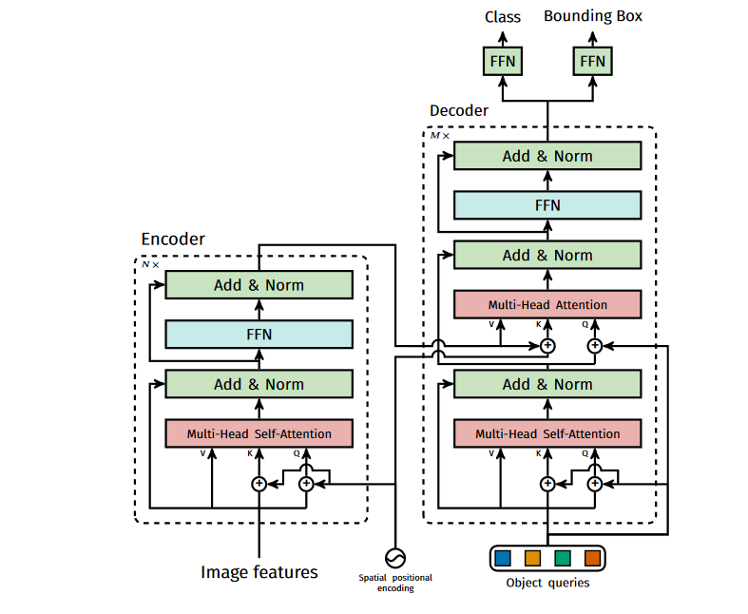
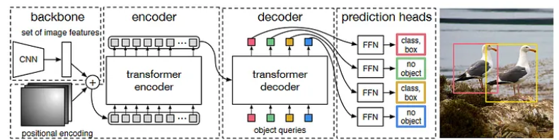
Vit Variants
DETR (Detection Transformer): Extends transformers for object detection tasks.
CNN backbone (ResNet-50) to extract features are passed to transformer’s encoder-decoder.
A simple feed forward network (FFN) that makes the final detection prediction.
m

Slide 30
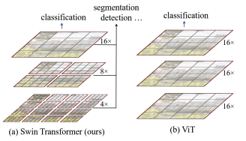
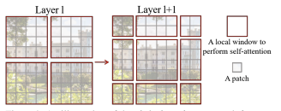
Vit Variants
Swin Transformer: Hierarchical ViT variant that builds representations at multiple scales, designed for image classification and object detection.
The input image is progressively downsampled through a series of stages. This allows the model to capture both local and global information efficiently.
Each stage in Swin Transformer employs shifted windows, which overlap with previous windows. This helps the model capture dependencies across different regions of the image.

Slide 31

Happy Learning!

